Slide 1
CREDIT EDA CASE STUDY
By : Akash Gaikwad
From Advanced Certification Program

Slide 2
OBJECTIVE
Identify patterns and relationships that help understand a customer's credit worthiness.
Understanding How Consumers and Lenders Affect the Default Propensity.
Check for patterns that indicate whether customers are having trouble paying for the setting so that appropriate action can be taken when evaluating the application.

Slide 3
STEPS TO FOLLOW
Read and Import Data files by using Pandas.
Check the missing data and null values and try to impute them with Mean/Mode/Median values.
Binning the data into the groups for easy analysis.
Check data imbalance for Univariate and Bivariate Analysis.
Merge the Application data with Previous data set.
Analyse the data set with Univariate and Bivariate Analysis.

Slide 4
About application data set:
The default table sizes for the application dataset are 307511 rows and 122 columns .
After cleaning the data, analysis was performed rows and columns are 307495 and 76 , respectively.
The analysis on this data set progressed by partitioning an variable TARGET on based on “no_difficulty_df_data” & “difficulty_df_data” referred to TARGET = 0 & TARGET = 1 respectively in the tables and chart.

Slide 5
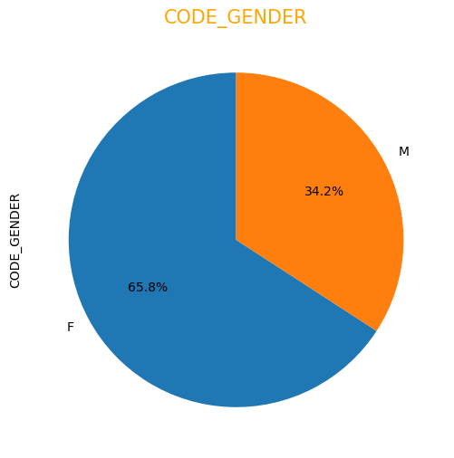
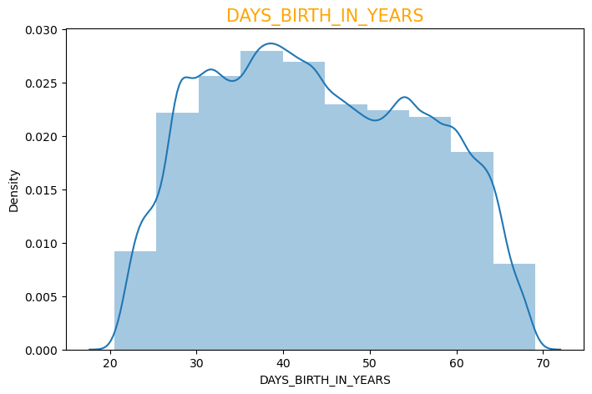
OBSERVATIONS
65.8% of loan applicants are
Females & only 34.2% are Males.
Age group of the loan category is
higher between 35-40.

Slide 6
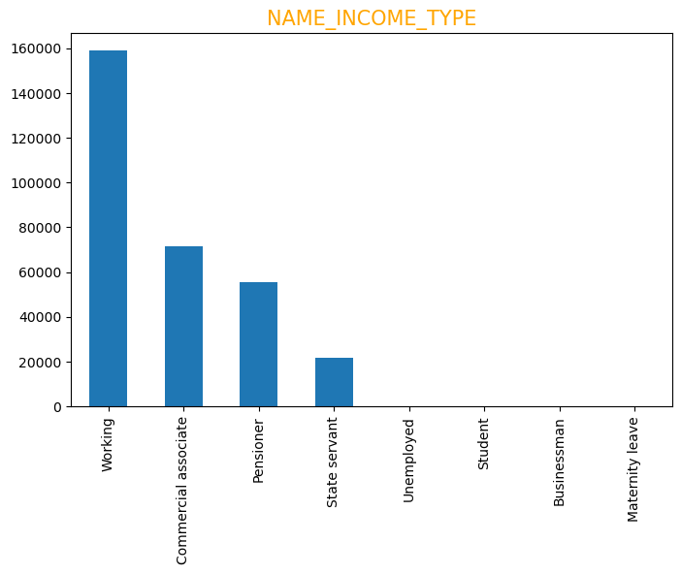
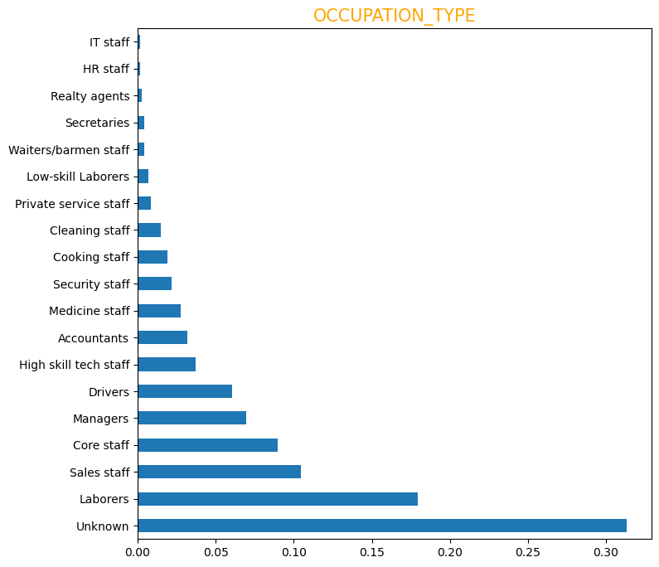
OBSERVATIONS
More than 50% of our loan
applicants are from 'Working'
category followed by
'Commercial Associate' &
'Pensioner' at the 3rd position.
Out of the 18 employment
categories labours have the
highest loan application

Slide 7
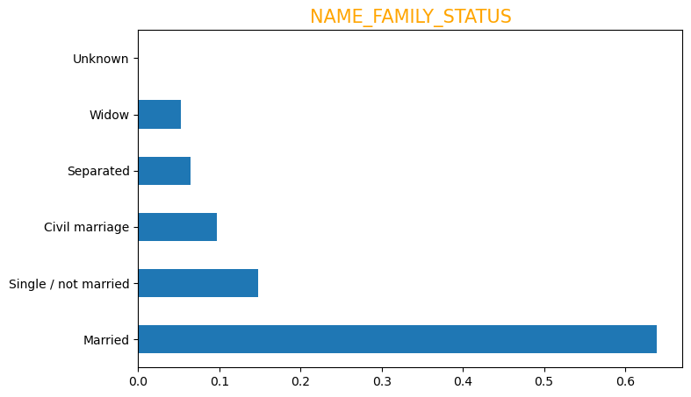
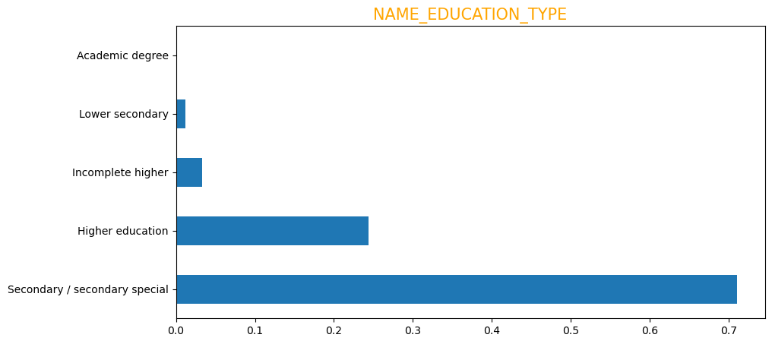
OBSERVATIONS
More than 73% of the applicant
are married customers.
Most of the loan applicants are in
the Secondary/secondary special
segment which comprises more
than 70% of the applicant.

Slide 8
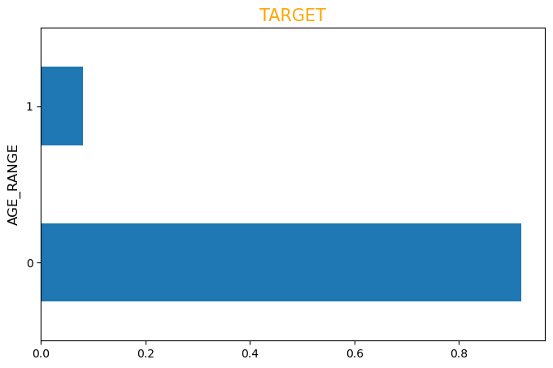
OBSERVATIONS
91.9% of the applicants by far has
been regular with their payments.
Only 8.1% have had at least 1
default/late payment.

Slide 9
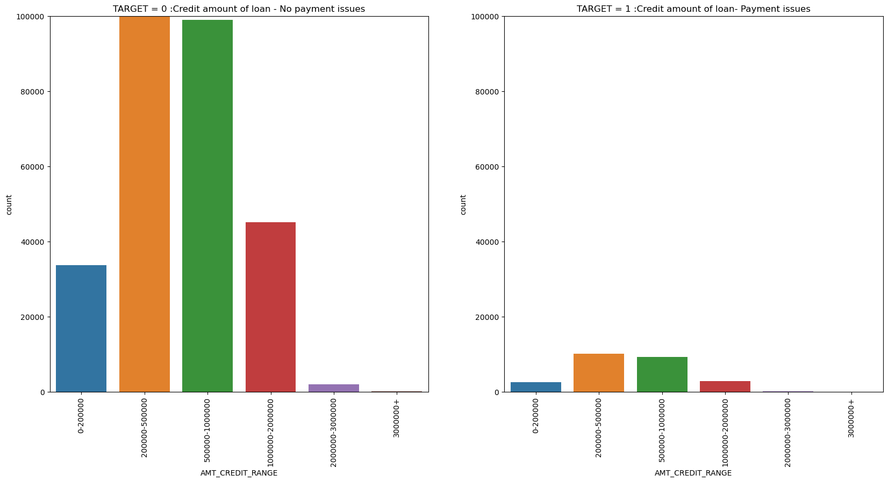
Credit Range vs Target
Customers with Credit range between 2,00,000 - 5,00,000 & 5,00,000 - 10,00,000 though have a higher number of defaulter their ratio in comparison to that of Target = 0 is much better than credit amount 0- 2,00,000 & 10,00,000 - 2,00,000

Slide 10
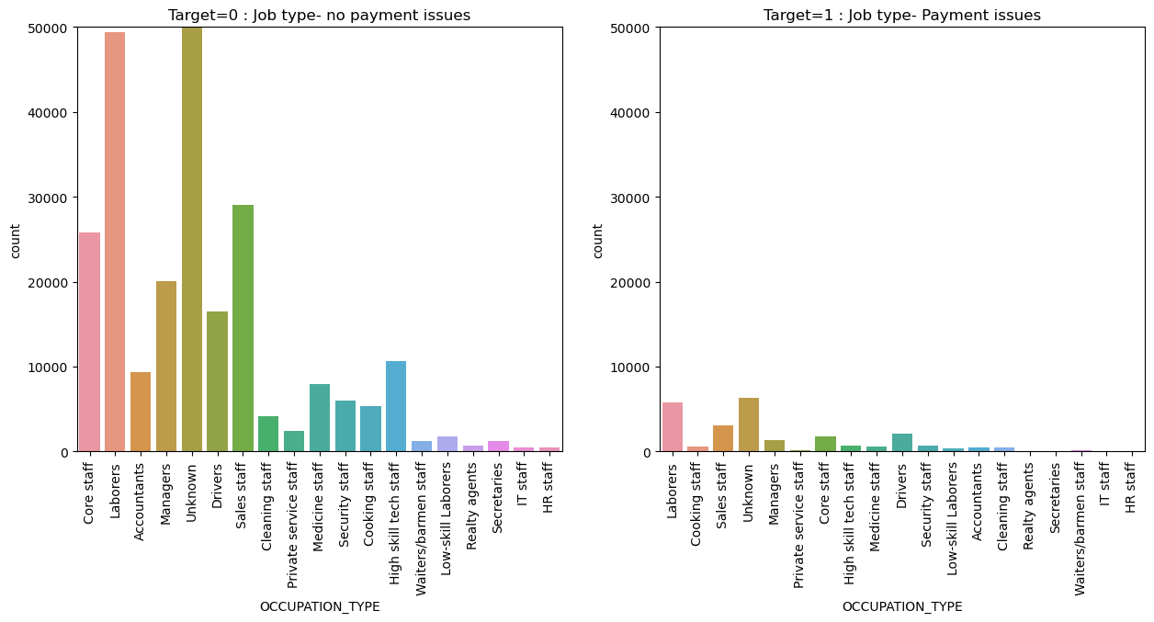
Occupation Type Vs Target
Categories like Managers, Sales staff, Drivers show a more unreliable tread in the payments.
Professions like High skill tech staff, Medicine staff, HR staff, IT staff, Secretaries, Reality agents are reliable for credits as they have low or nil payment issues.

Slide 11
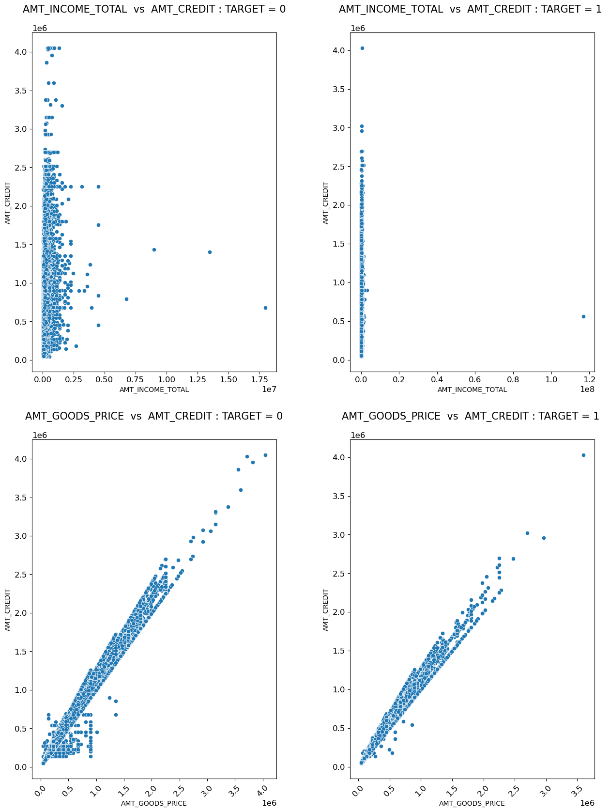
NUMERICAL_NUMERICAL ANALYSIS
People who pay off their loans on time get better loans.
Many low income people have difficulty paying their bills and therefore have lower rates. Goods_price has a relationship with Credit. Customers who pay back on time and have a high credit score have higher creditworthiness.

Slide 12
CONCLUSION
Banks should focus more on “Student”, “Retired” and “Businessman” contracts for profitable business.
Banks should focus less on “Work” “income type so as not to lose money” organization as it has the highest payout.

Slide 13
Thank You

